Slide 1
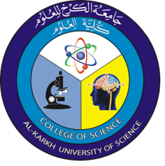
Optics Laboratory
2nd Grade - 1st Semester
2018/2019
Instructors
Assist. Prof. Dr. Sabah Ibrahim
Assist. Lect. Muhanned Jamal
Assist. Lect. Najwa Ibrahim

Slide 2
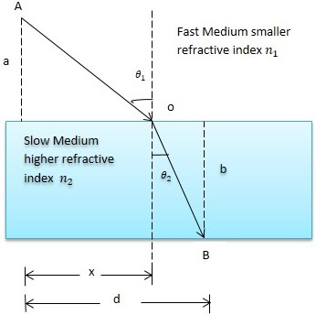
Experiment Six Snell’s Law
Apparatus:
Laser light source, Protractor, Rectangular glass transparent.
Theory:
Fermat’s principle: light follows the path of least time. Snell’s law can be derived by setting
the derivative of the time equal to zero.

